Slide 1

SDM INSTITUTE OF TECHNOLOGY
DEPARTMENT OF COMPUTER SCIENCE & ENGINEERING
“Stroke detection using ai”
Under the guidance of
Mr. Pradeep GS
Assistant Professor
Department of CSE
SDMIT, Ujire
Presented By
Ganesh K
Nagashree Uday Bhat
Nidhi Kothwal
TEAM ID: P7

Slide 2
INTRODUCTION
Stroke Detection System: This advanced platform is designed to predict the likelihood of brain strokes using medical and health data. It leverages data analytics and machine learning algorithms to assess risk factors such as age, hypertension, heart disease, and lifestyle habits.
The platform provides an intuitive interface for healthcare professionals and individuals to input relevant data and receive accurate stroke risk predictions. It aims to promote early detection, enhance preventive care, and support personalized health interventions, ultimately improving patient outcomes and reducing healthcare costs.

Slide 3
LITERATURE SURVEY
In the paper titled “Stroke Risk Prediction with Machine Learning Techniques” (2022) [1], this study presents a machine learning-based framework for predicting long-term stroke risk. It highlights the use of stacking classifiers, which achieved an impressive accuracy of 98%. The models were validated using metrics such as AUC, precision, recall, and F-measure, demonstrating their effectiveness in improving early risk assessment and management of stroke​
In the paper titled "Machine Learning in Action: Stroke Diagnosis and Outcome Prediction" (2021) [2], this paper explores machine learning models for stroke diagnosis and prognosis, emphasizing feature selection, model validation strategies, and addressing biases in datasets. It demonstrates how machine learning enhances diagnostic precision and outcome predictions in clinical environment

Slide 4
LITERATURE SURVEY
In the paper titled "Artificial Intelligence: A Shifting Paradigm in Cardio-Cerebrovascular Medicine" (2021) [3], this study discusses the transformative role of artificial intelligence in stroke care, particularly in diagnostics and emergency stroke management. It introduces practical frameworks for integrating AI tools into real-world medical applications, offering insights into improved stroke detection and care ​efficiency
In the paper titled "Using Artificial Intelligence for Improving Stroke Diagnosis in Emergency Departments" (2020) [4], this research outlines AI-based methods for rapid and accurate stroke diagnosis in emergency settings. The proposed models are designed to enhance decision-making, ensuring faster and more reliable identification of stroke cases in critical situations

Slide 5
LITERATURE SURVEY
In the paper titled Machine Learning Models for Predicting Stroke Risk: A Review of Recent Studies" (2021) [5], this paper published in Frontiers in Neurology, the authors explore the use of machine learning for stroke prediction, emphasizing the importance of feature selection techniques and model validation strategies. The study evaluates models like Random Forest, Logistic Regression, and Support Vector Machines, achieving over 90% accuracy with optimized datasets. Case studies highlight real-world applications in clinical environments, showcasing the potential to improve early diagnosis and intervention strategies.

Slide 6
PROBLEM STATEMENT
Early Detection of Strokes: Early detection of strokes is crucial for effective treatment, but current methods often rely on manual assessments that can be time-consuming and error-prone. There is a need for an automated, data-driven approach to predict stroke risk using patient data. This project aims to develop a machine learning model that leverages factors such as age, hypertension, glucose levels, and other health indicators to accurately predict the likelihood of a stroke.
By providing healthcare professionals with timely, data-driven insights, the model can aid in early intervention, reducing stroke-related fatalities and improving patient outcomes.

Slide 7
OBJECTIVES
Develop an accurate stroke prediction model.
Create a user-friendly interface.
Ensure model reliability and security.
Provide real-time, data-driven predictions.
Early Detection.

Slide 8
HARDWARE AND SOFTWARE REQUIREMENTS
Sl. No | Hardware/Equipment | Specification
1. | Processor | Intel i5/i7 cores
2. | Hard Disk | 100 GB
3. | RAM | 16 GB
Sl. No | Software | Specification
1. | Jupyter | 64 bit
2. | Python | Version 3.13
3. | Language | Python, Html, CSS, JS
4. | Library | Flask, Joblib, Pickle, Numpy

Slide 9
METHODOLOGY
Step 1: Data Collection
Collect relevant healthcare data, including patient demographics etc.
Step 2: Data Preprocessing
Handle missing values, normalize numeric features.
Step 3: Model Selection and Training
Use logistic regression or decision tree models to classify patients.
Step 4: Model Evaluation and Validation
Evaluate the model using key metrics .
Step 5: Model Deployment and Integration
Deploy the final model through an accessible user interface.

Slide 10
APPLICATIONS
Early Detection and Diagnosis.
Personalized Patient Monitoring.
Research and Analytics.
Emergency Management.
Health Risk Prediction for General Public.

Slide 11
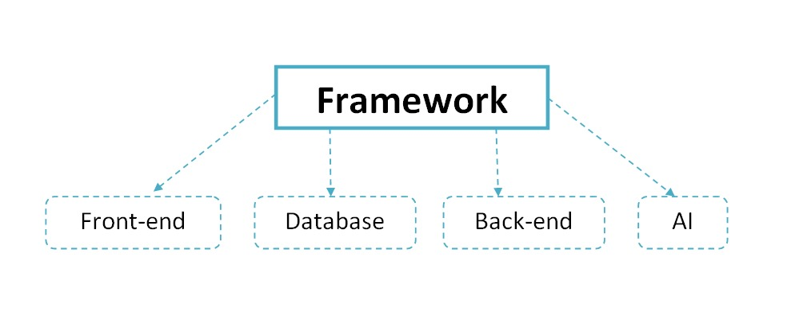
SYSTEM DESIGN
Proposed Architecture:

Slide 12
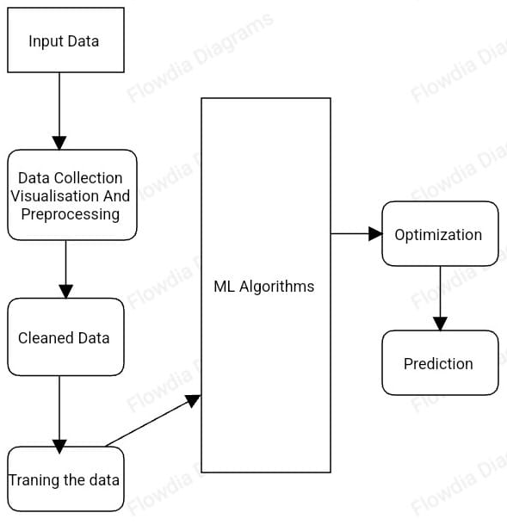
SYSTEM DESIGN
System Flowchart:
User --> Home --> Input --> Get Result --> View --> Exit.

Slide 13
ALGORITHMS
The application uses several algorithms for user accuracy, mean calculation, nearest path and outlier removal.
K-Nearest Neighbors (KNN)
Choose the number of neighbors (K).
Calculate the distance between the query point and all data points.
Sort the distances and find the K nearest neighbors.
For classification, assign the majority class label from the neighbors.
Optionally, apply distance-based weighting.
Output the predicted class (for classification) or value (for regression).

Slide 14
ALGORITHMS
Random Forest Algorithm:
Bootstrap Sampling: Create multiple random subsets of the original data with replacement.
Train Multiple Decision Trees: For each bootstrap sample, train a decision tree using a random subset of features at each node.
Make Predictions: For classification, use majority voting; for regression, average the predictions.
Aggregate Predictions: Combine the predictions of all trees to obtain the final prediction.
Model Evaluation: Evaluate the model using cross-validation and performance metrics

Slide 15
ALGORITHMS
Decision Tree Algorithm:
Select the best feature to split the dataset using a splitting criterion (e.g., Gini Index, Entropy, Variance Reduction).
Split the dataset into subsets based on the selected feature.
Recursively repeat the process for each subset until a stopping condition is met.
Assign a class label (for classification) or a value (for regression) at the leaf nodes.
Optionally, prune the tree to avoid overfitting and improve generalization.
Use the tree to make predictions for new data points by traversing from the root to the appropriate leaf.

Slide 16
ALGORITHMS
Logistic Regression:
Define Hypothesis: Use the sigmoid function to model the probability of the positive class.
Initialize Parameters: Randomly initialize the model’s weights.
Compute Cost Function: Calculate the logistic loss function (cross-entropy).
Update Parameters: Use gradient descent to minimize the cost function by updating the weights.
Make Predictions: Apply the model to new data and classify based on a threshold probability.
Evaluate Performance: Use appropriate metrics to evaluate the model’s effectiveness

Slide 17
ALGORITHMS
Support Vector Machine Algorithm:
Map Data to Higher Dimensions: Apply the kernel to transform the input data into a higher-dimensional feature space and define the optimal hyperplane.
Maximize the Margin: Use optimization techniques to maximize the margin and find the support vectors.
Solve the Optimization Problem: Use quadratic programming or SMO to find the optimal parameters for the hyperplane.
Make Predictions: Use the decision function to classify new data points based on the learned hyperplane.
Evaluate the Model: Assess the model’s performance using relevant evaluation metrics

Slide 18
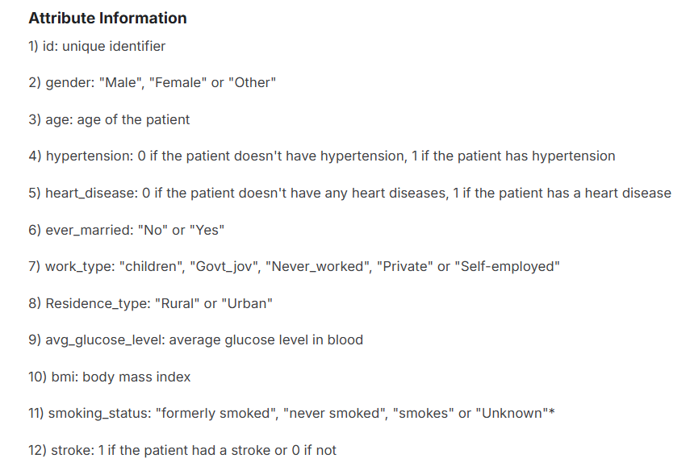
DATASETS

Slide 19
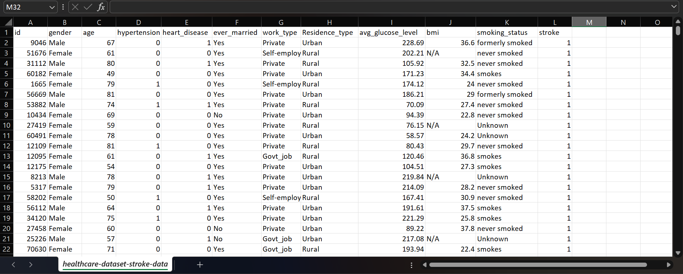
DATASETS
The image below displays the data collection from the Kaggle database in Microsoft Excel. Key fields include: ID (unique identifier), Gender, Age, Hypertension, Heart Disease, etc. This setup ensures efficient management and retrieval of data resources for stroke risk prediction.

Slide 20
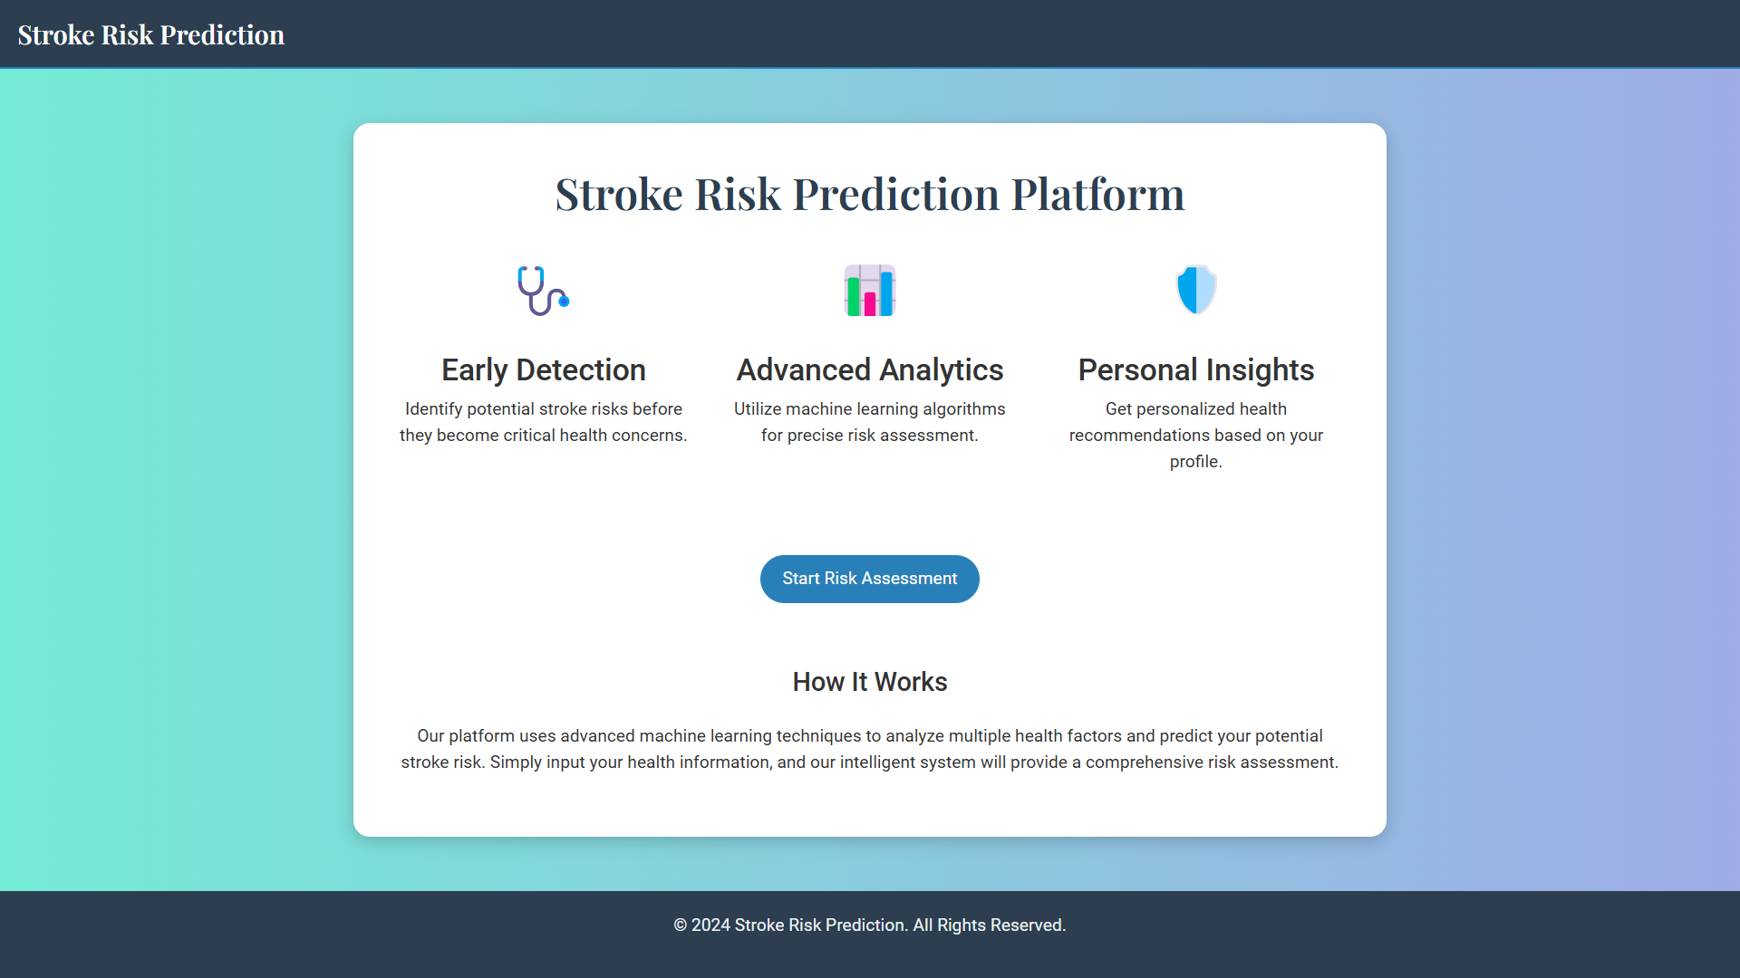
IMPLEMENTATION
A comprehensive digital health platform utilizing advanced machine learning algorithms to predict and prevent brain strokes.

Slide 21
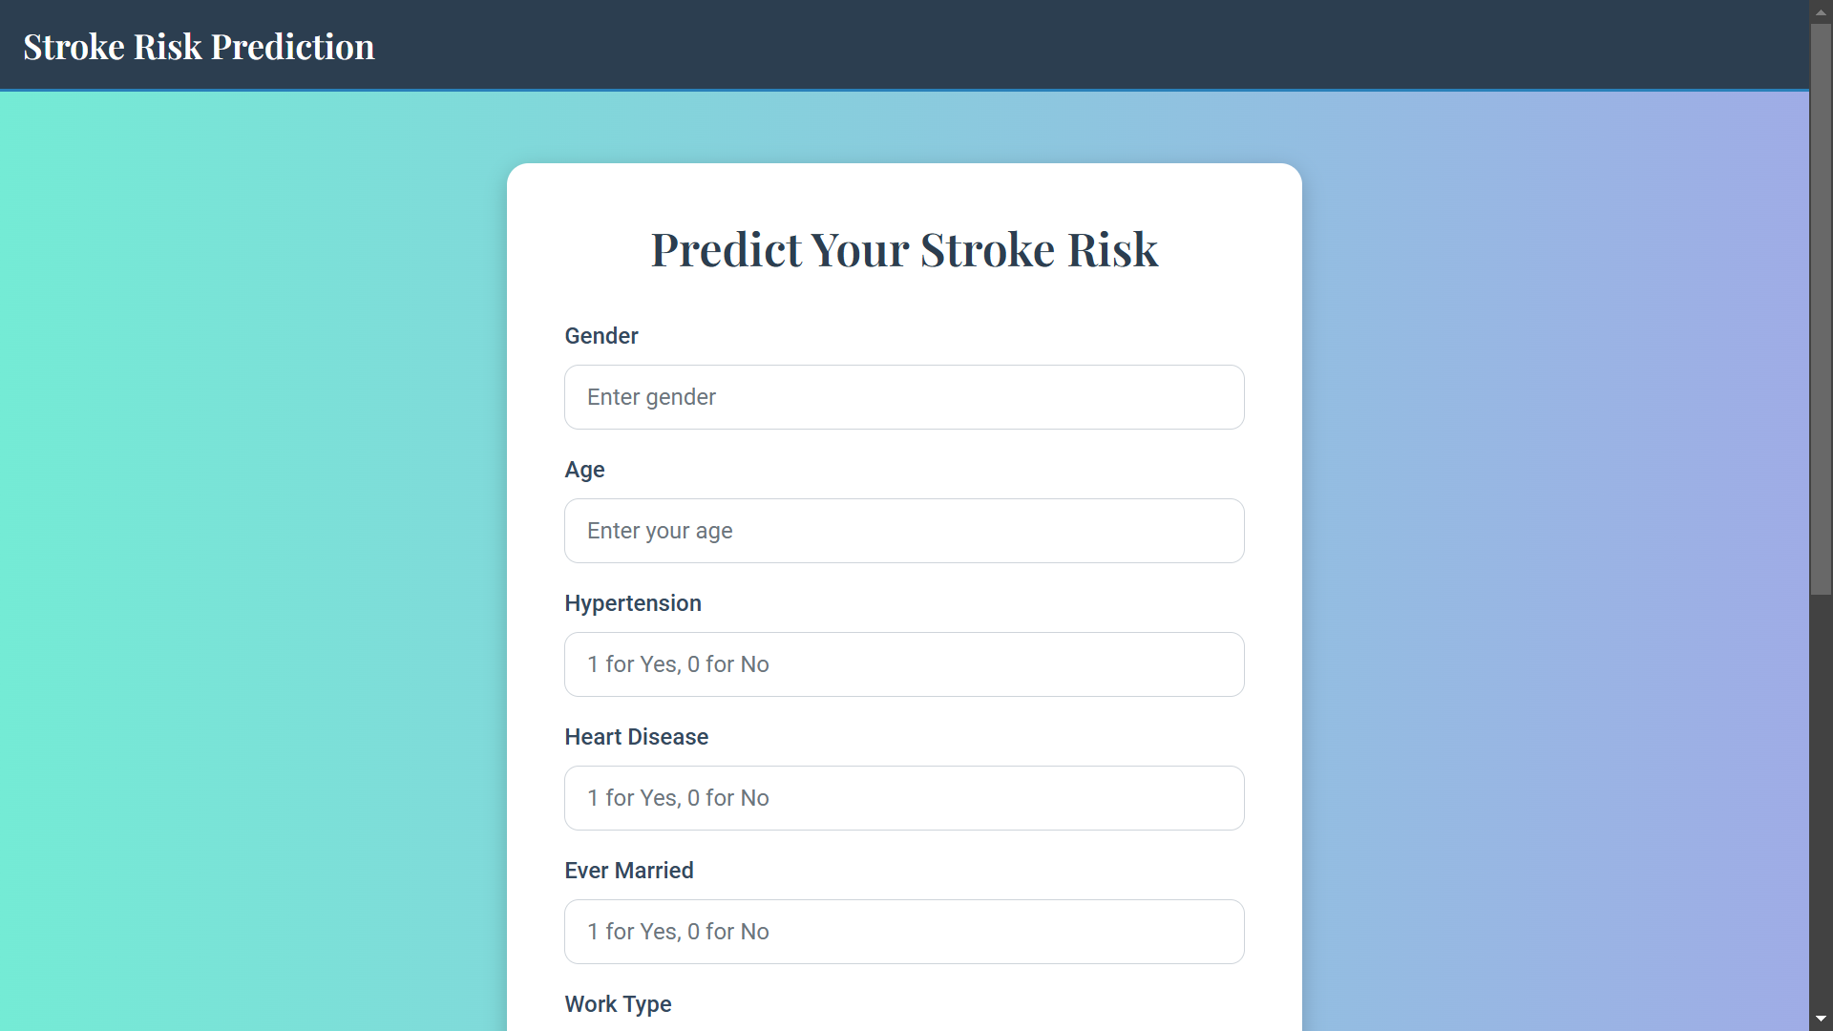
IMPLEMENTATION
User Input: Users can provide input to receive results. This feature is implemented using standard authentication protocols to ensure data security.

Slide 22
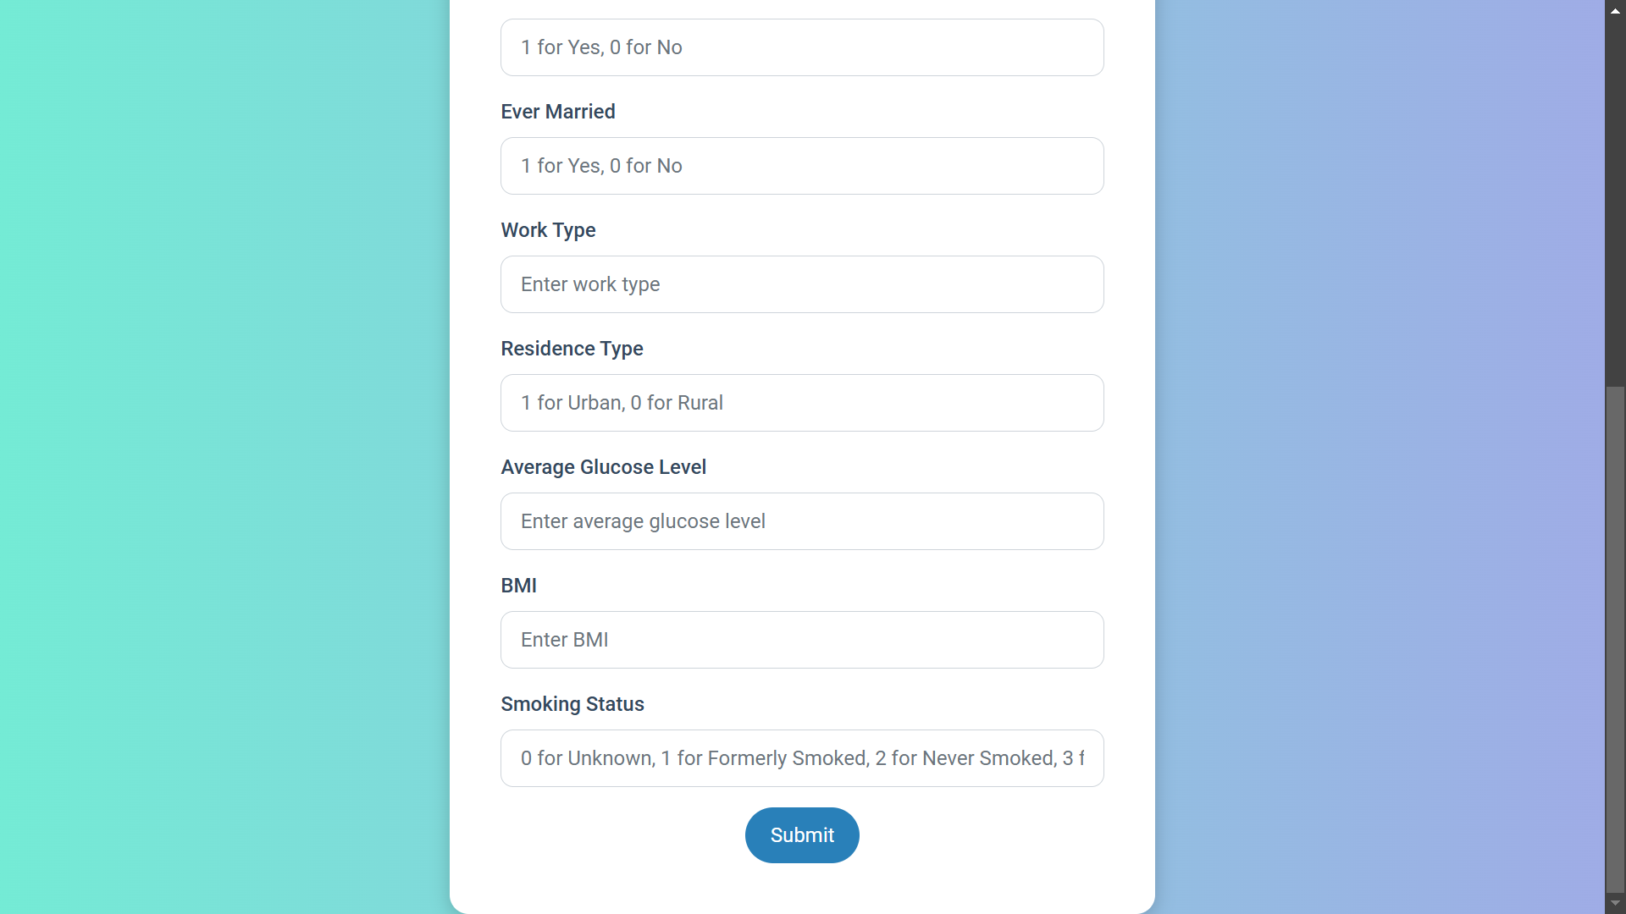
IMPLEMENTATION
User-Friendly Interface:.

Slide 23
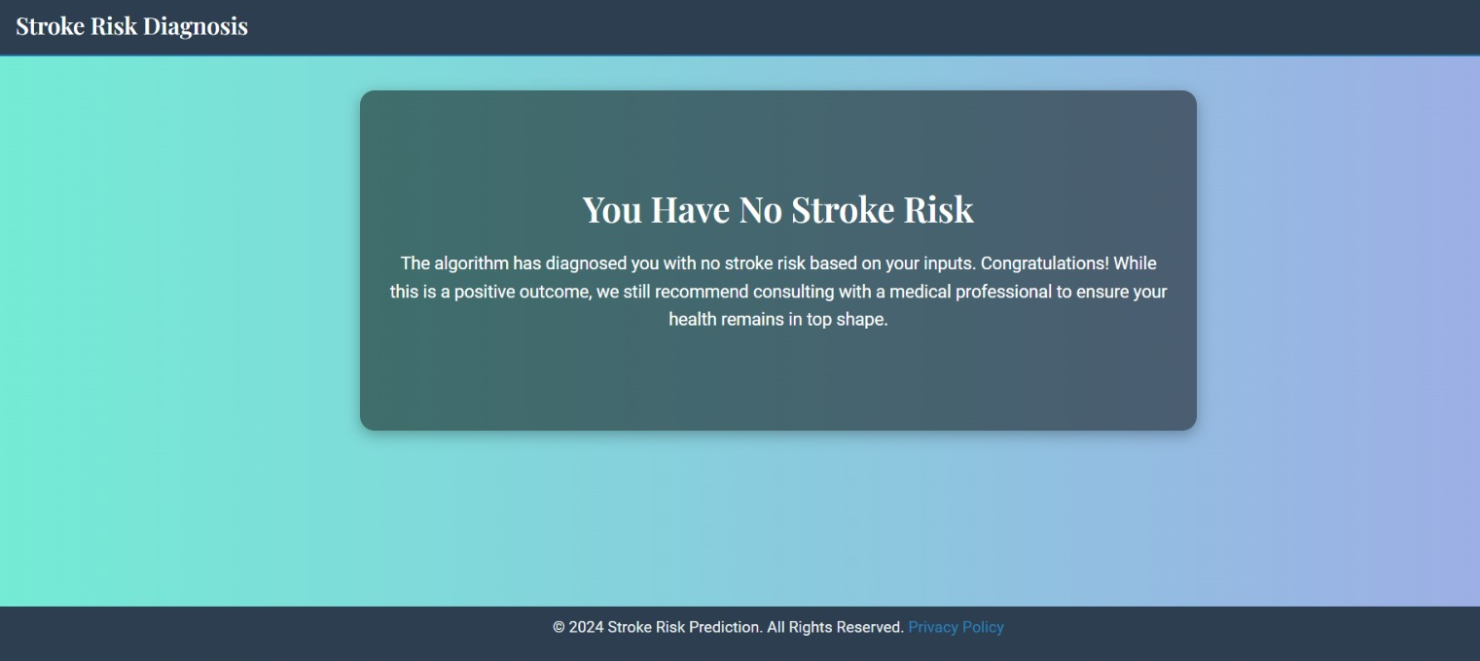
IMPLEMENTATION
No Stroke Risk: Based on the user input, the trained AI model will evaluate the conditions or situation and indicate no stroke risk when everything is within normal parameters.

Slide 24
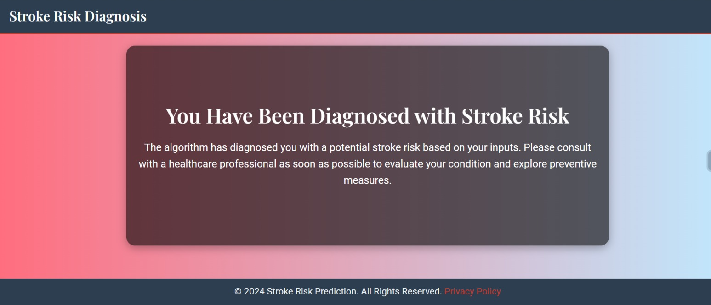
IMPLEMENTATION
Stroke Risk: Based on the user input, the trained AI model will evaluate the conditions or situation and indicate a stroke risk. If a risk is detected, it is recommended to visit a doctor for further evaluation.

Slide 25
IMPLEMENTATION
Database: A robust system that securely stores user information and data. Implemented using the Kaggle database for efficient data management.

Slide 26
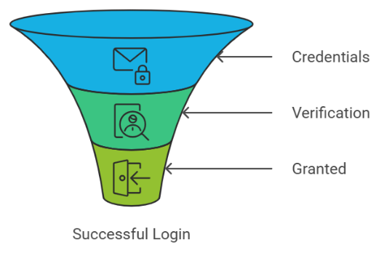
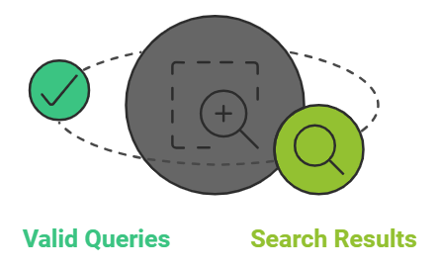
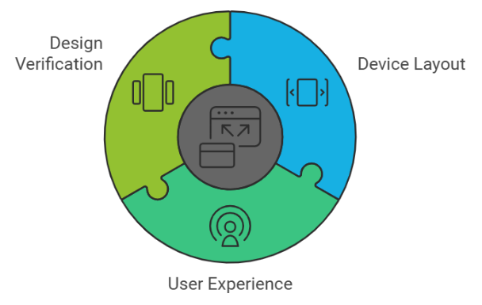
SYSTEM TESTING
User Input:
Verify User input in given cell.
Data Validation:
Verify data with valid dataset for result.
Responsive Design:
Verify website layout on application.

Slide 27
RESULT ANALYSIS
The result analysis focuses on evaluating the performance of the trained machine learning models on the test dataset. Key metrics such as: Accuracy, precision, recall, F1-score, and AUC-ROC
Training Size | Testing Size | Accuracy(%)
 |  | KNN | DT | LR | SVM | RF
80% | 20% | 94.6 | 90.99 | 94.61 | 94.71 | 94.22

Slide 28
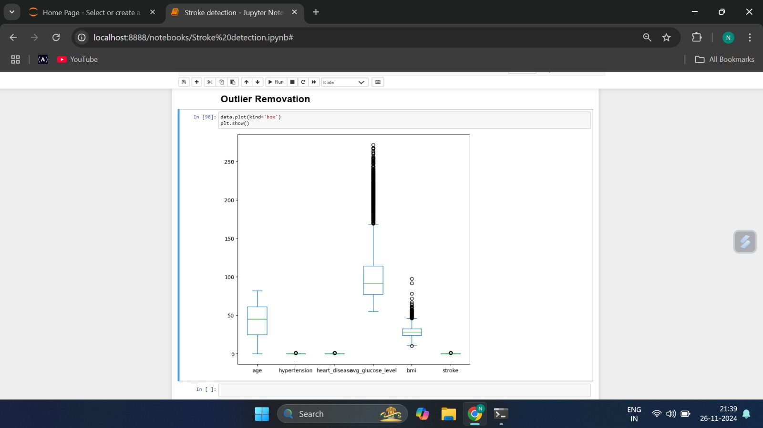
RESULT ANALYSIS
Box graph for the accuracy of the algorithms where the train size and test size is specified.

Slide 29
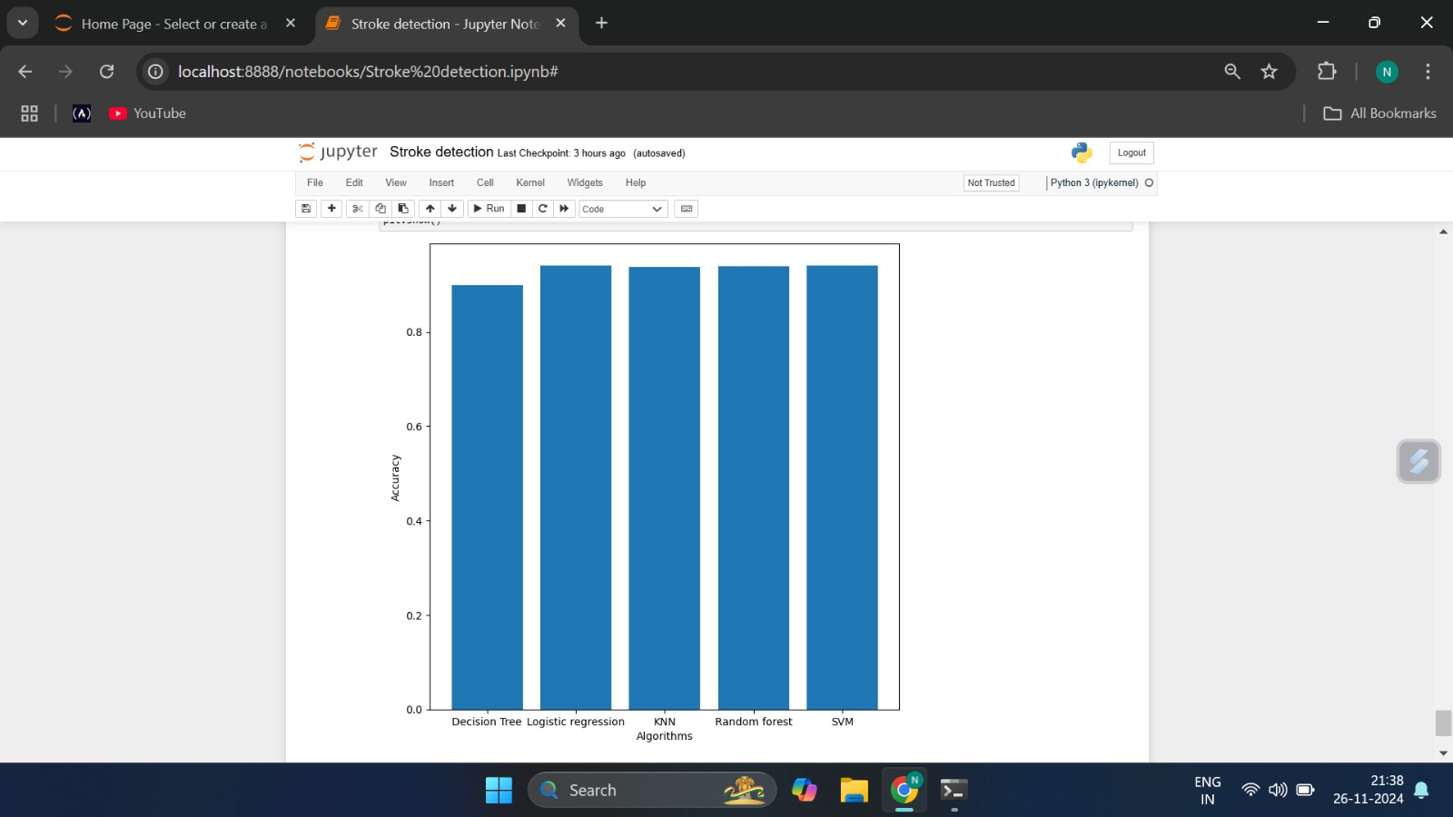
RESULT ANALYSIS
Bar graph for the accuracy of the algorithms.

Slide 30
CONCLUSION & SCOPE FOR FUTURE WORK
Conclusion:
Its user-friendly design and accurate predictions provide valuable insights to healthcare providers and individuals, enabling timely preventive measures and reducing the risks associated with strokes.
Future Scope:
Real-Time Monitoring.
Collaboration with Healthcare Systems:
Integration of Advanced Models.

Slide 31
REFERENCES
Kaggle Dataset for Stroke Prediction Kaggle-Dataset
Stroke Risk Prediction with Machine Learning Techniques Stroke Risk Prediction
Machine Learning in Action: Stroke Diagnosis and Outcome Prediction ​Machine Learning in Action
Artificial Intelligence: A Shifting Paradigm in Cardio-Cerebrovascular Medicine Shifting Paradigm
Using Artificial Intelligence for Improving Stroke Diagnosis in Emergency Department. ​Improving Stroke Diagnosis
Machine Learning Models for Predicting Brain Stroke Risk: A Review of Recent Studies. Machine Learning Models

Slide 32
Thank You

